Slide 1

TAXI SERVICES CIS 5200
Group 3
Himani Batra
Katia Kermoyan
Nishant Shristiraj
Srihitha Reddy Sivannagari

Slide 2
GOAL
Study current transportation services to understand the market and build a business model.

Slide 3
BACKGROUND
A group of entrepreneurs interested in starting a new transportation services company.
Our belief: The increase in population and traffic has also increased the usage of taxis in metropolitan cities like Chicago and New York.

Slide 4
GOAL
Study current transportation services in Chicago and New York to understand the market and build a business model.

Slide 5
Main Objective
Study data about existing services and derive meaningful insights and relationships between the extent of taxis used in Chicago and New York
Major Insights
Companies doing successful business
Communities where most number of rides were requested
Busiest hour of the day

Slide 6

H/W EXPERIMENTAL SPECIFICATIONS
Version: IOP 4.2
Number of Nodes: 1 DATA NODE
Memory Size: 24 GB RAM
Number of CPUs: 4 VCPU
DATA DISK: 1TB SATA
Number of Nodes: 1 MANAGEMENT NODE
Memory Size: 48 GB RAM
Number of CPU: 12 VCPU

Slide 7
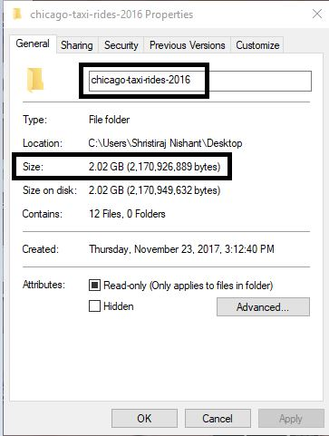
SPECIFICATIONS OF DATA SET
Data Set 1:
https://www.kaggle.com/chicago/chicago-taxi-rides-2016
Data set size: 2.020051 GB

Slide 8
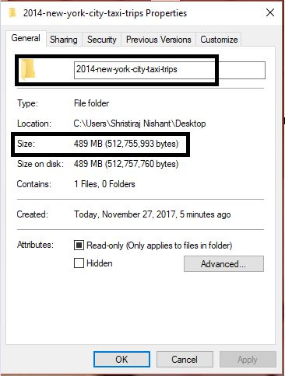
SPECIFICATIONS OF DATA SET
Data Set2:
https://www.kaggle.com/kentonnlp/2014-new-york-city-taxi-trips
Data set size: 489 MB

Slide 9





TOOLS USED

Slide 10
FLOWCHART OF DATA ANALYSIS
Download 2 data Sets from Kaggle.com
Tableau?
Create Visuals by Tableau?
Upload datasets into HDFS
Excel?
Create External tables in Hive
Queried date in Hive and Pig

Slide 11
INSIGHTS
What is the total monthly dispute for taxis in Chicago in 2016?Comparison between the disputed amount and the total amount.
What is the total number of pick-ups for each month in Chicago(2016)?
Which community of Chicago has the maximum miles travelled by taxi in 2016?

Slide 12
INSIGHTS
Which companies have the highest earnings in Chicago in 2016?
Which communities in Chicago have the highest demand for pick-ups? Drop-offs?
Which taxi-ids have the highest pickups? Generate the highest total fares?

Slide 13
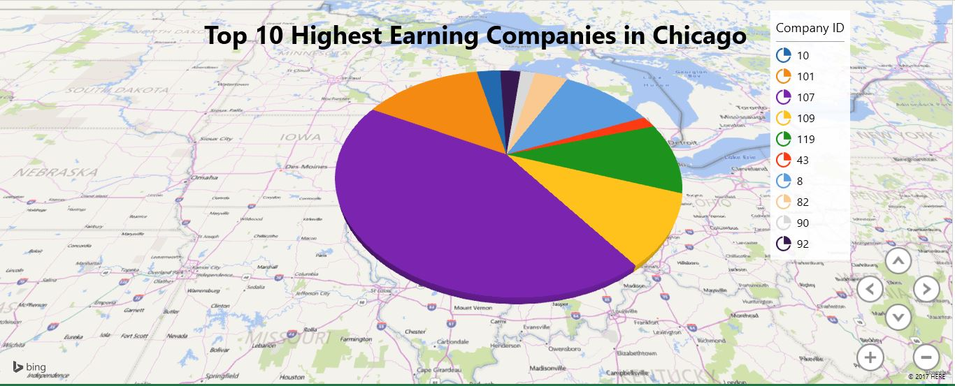
1. Which companies have the highest earnings in Chicago in 2016?

Slide 14
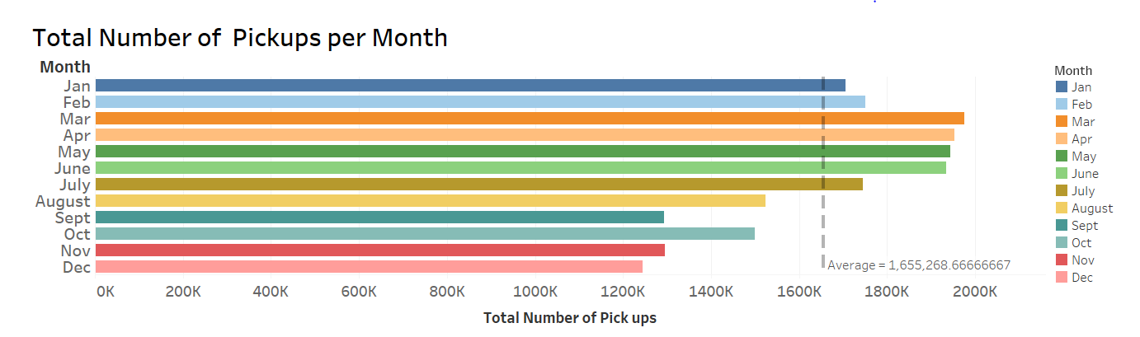
3. What is the total number of monthly pick-ups in Chicago(2016)?

Slide 15
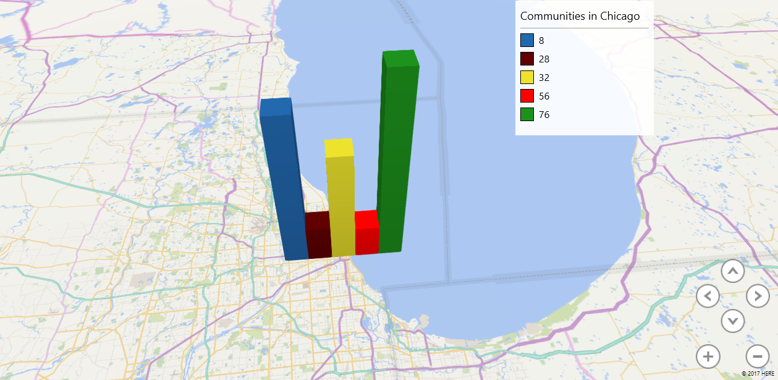
3. Which community of Chicago has the maximum miles travelled by taxi in 2016?

Slide 16
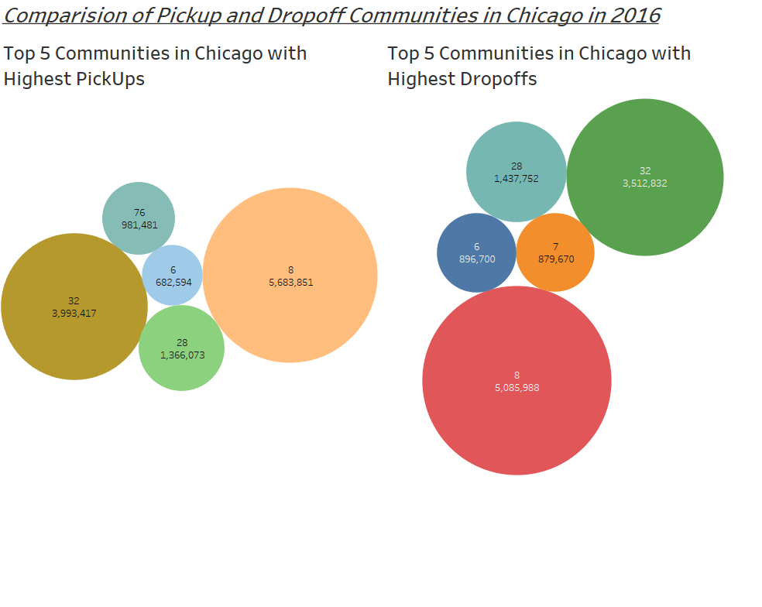
5. Which communities in Chicago have the highest demand for pick-ups and Drop-offs?

Slide 17
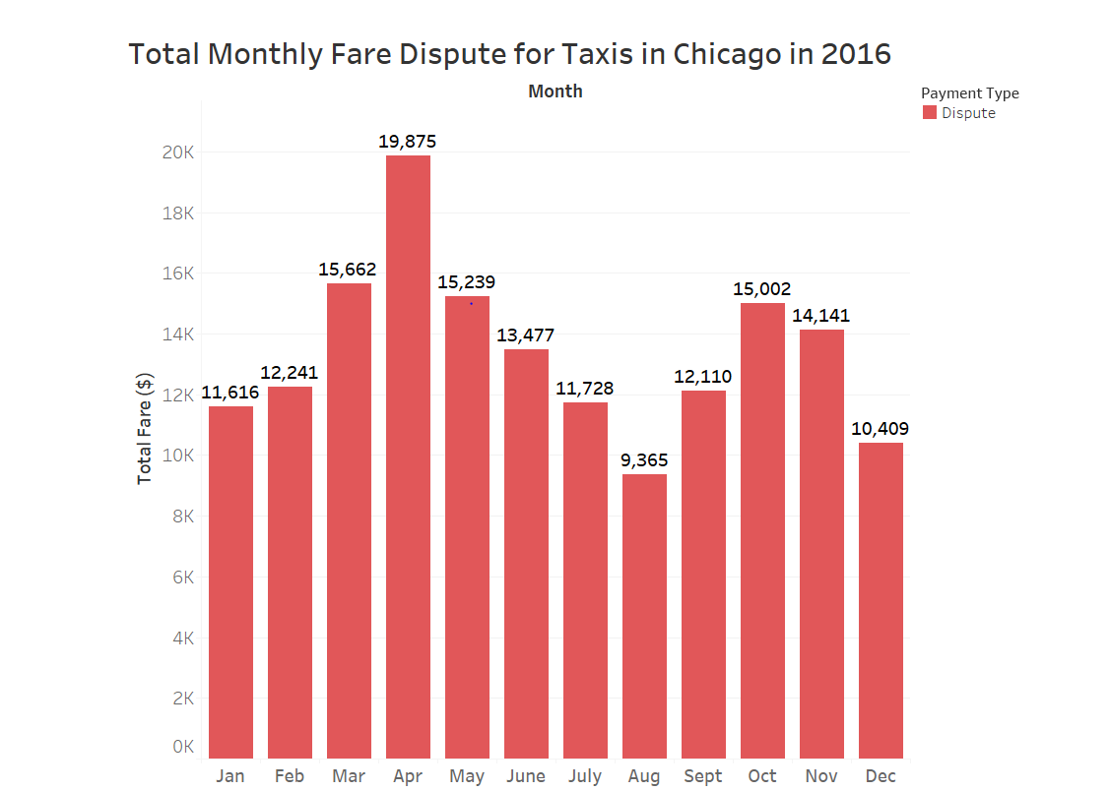
6. What is the total monthly fare dispute for taxis in Chicago in 2016?

Slide 18
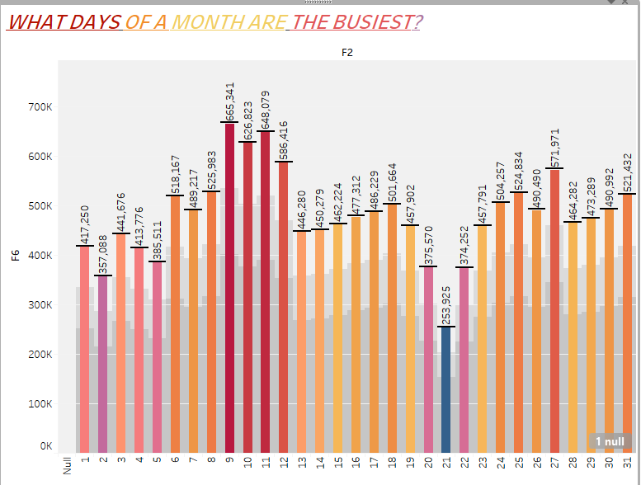
HOW MANY PICKUPS IN NEW YORK? WHICH HOUR OF THE DAY IS THE MOST BUSIEST? WHCIH DAY OF A MONTH HAS MOST PICKUPS?

Slide 19
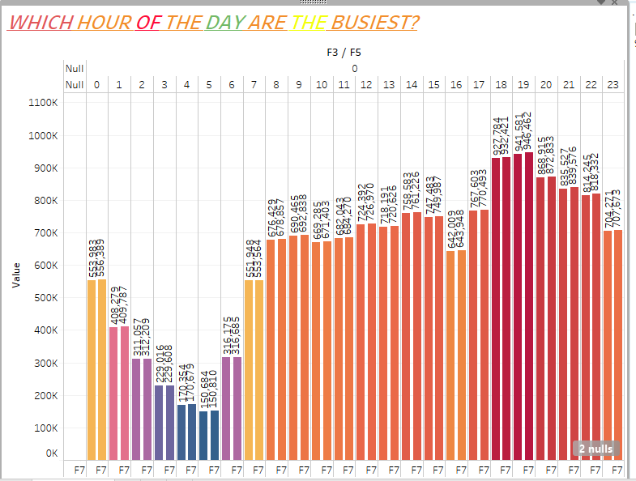

Slide 20
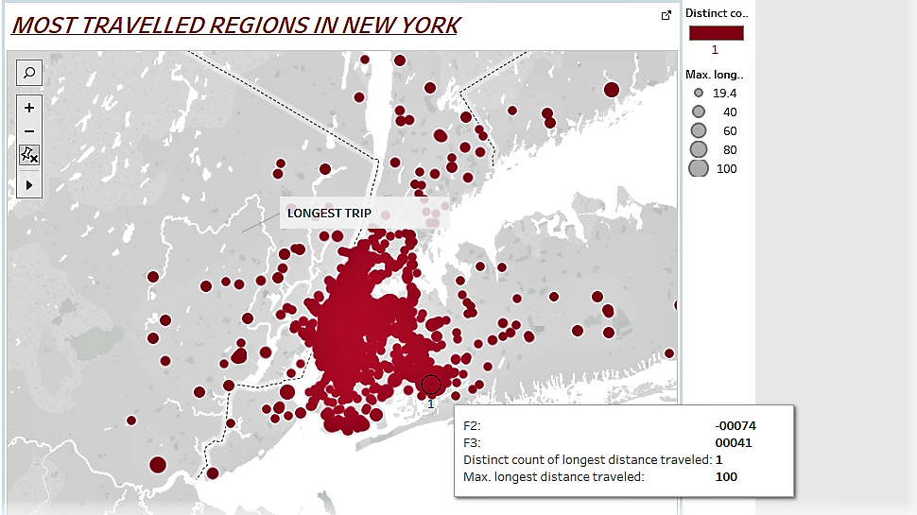
WHICH ARE THE REGIONS WITH HIGHEST DEMAND AND LONGEST DISTANCES TRAVELLED IN NEW YORK?

Slide 21
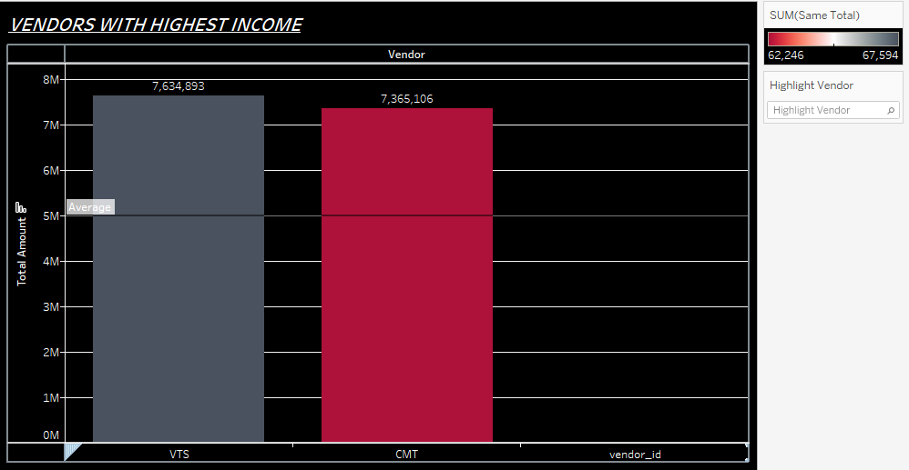
WHICH VENDORS WITH HIGHEST DEMAND AND INCOME?

Slide 22
PREDICTIVE ANALYSIS
WITH AZURE ML

Slide 23
LINEAR REGRESSION MODEL FOR NEW YORK DATA SET
WITH AZURE ML

Slide 24
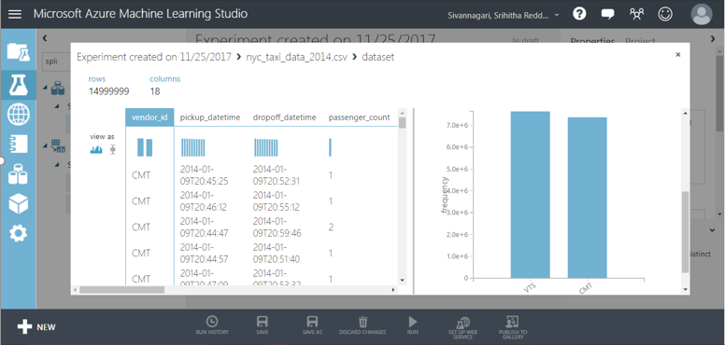
VISUALIZING NEW YORK DATA IN AZURE ML

Slide 25
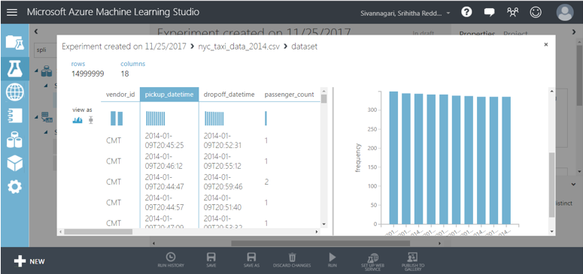

Slide 26
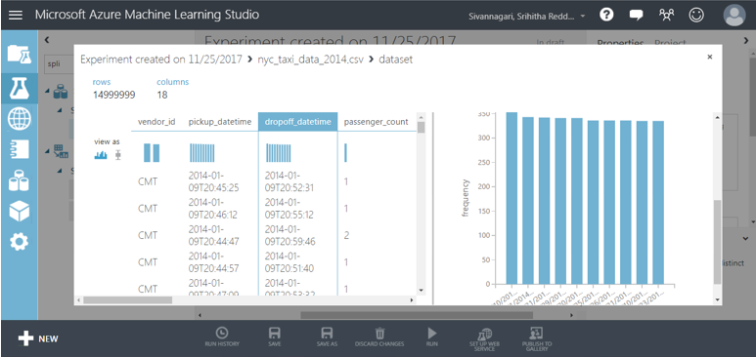

Slide 27
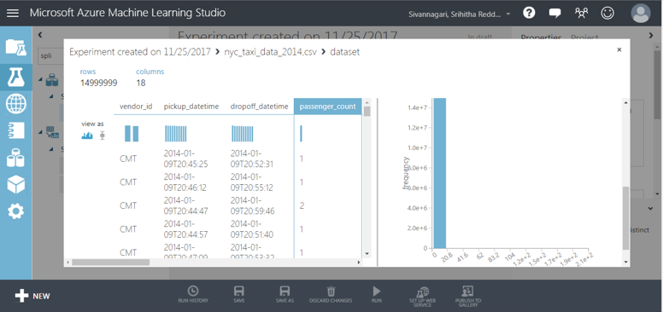

Slide 28
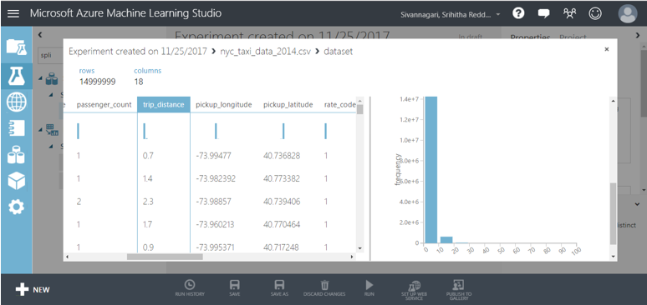

Slide 29
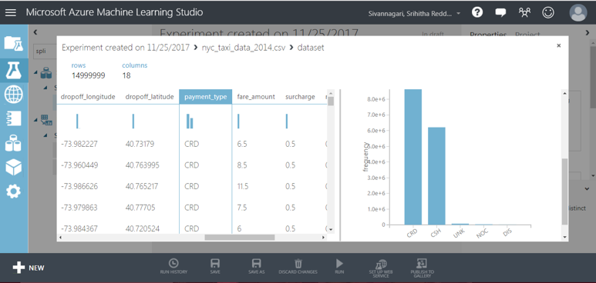

Slide 30
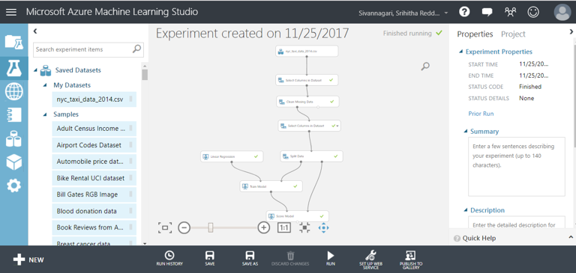

Slide 31
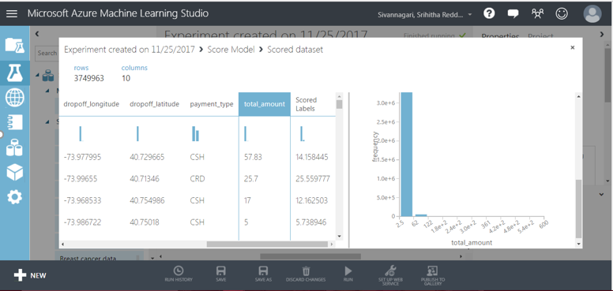
SCORED LABLE – PREDICTED TOTAL_AMOUNT

Slide 32
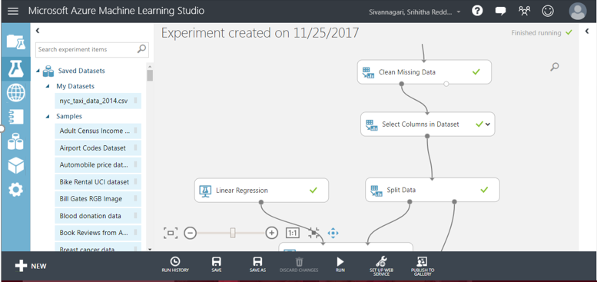

Slide 33
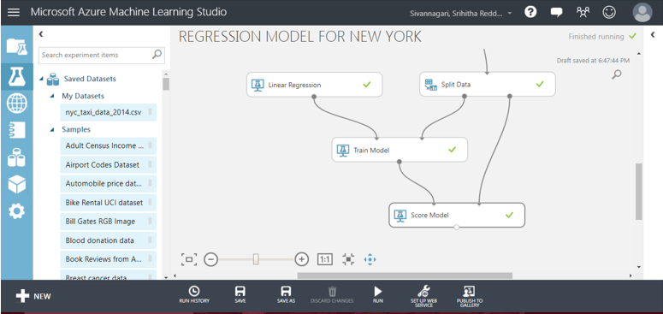

Slide 34
LINEAR REGREGRESSION MODEL FOR CHICAGO DATASET
WITH AZURE ML

Slide 35
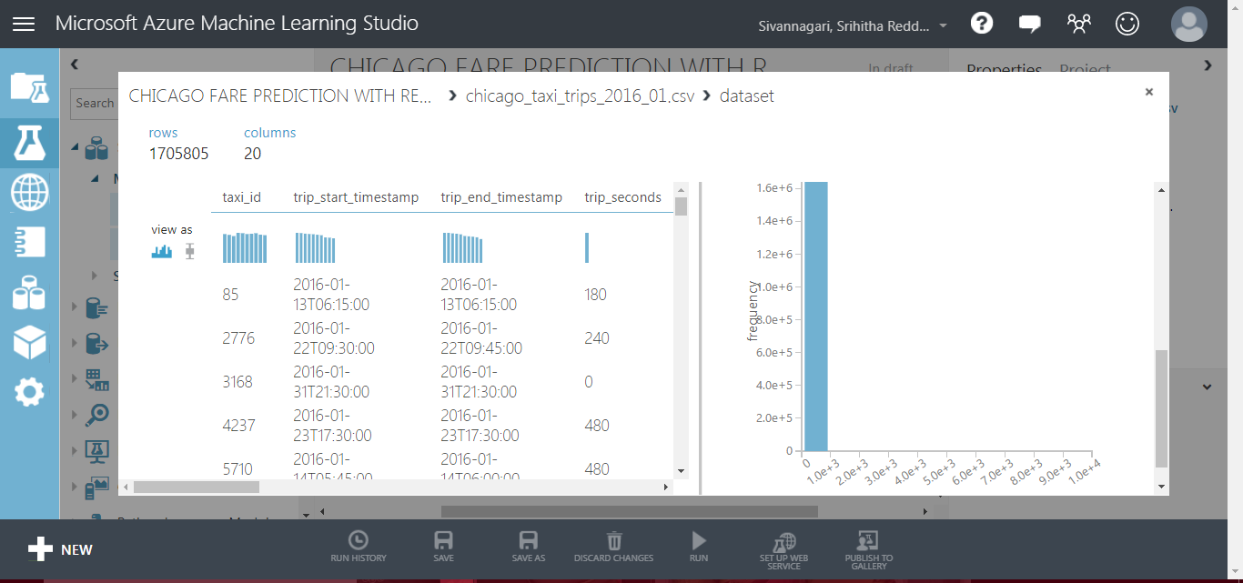
VISUALIZING NEW YORK DATASET IN AZURE ML

Slide 36
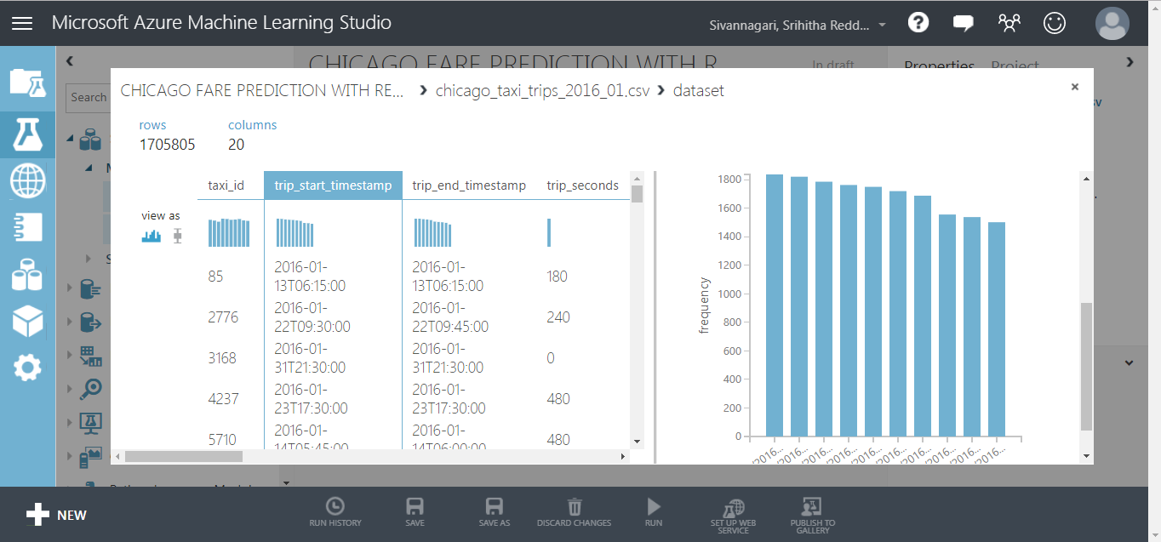

Slide 37
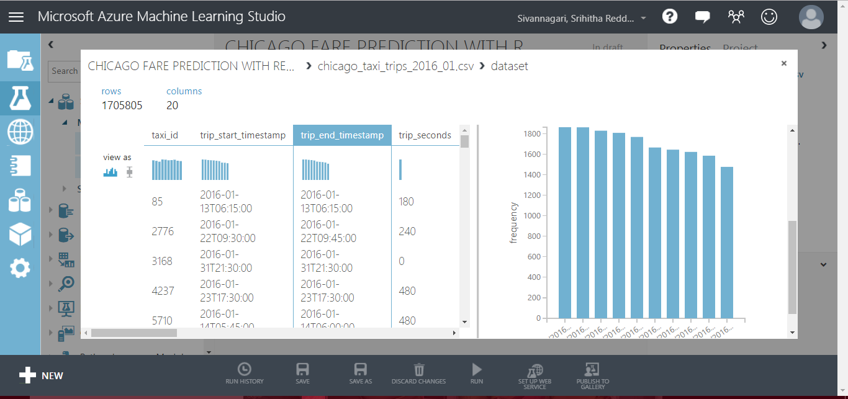

Slide 38
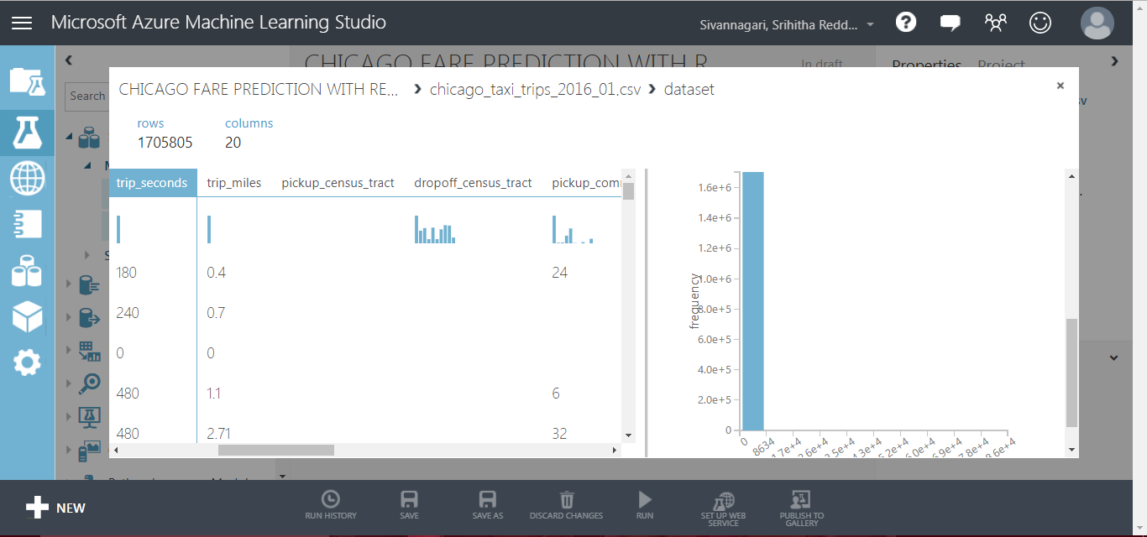

Slide 39
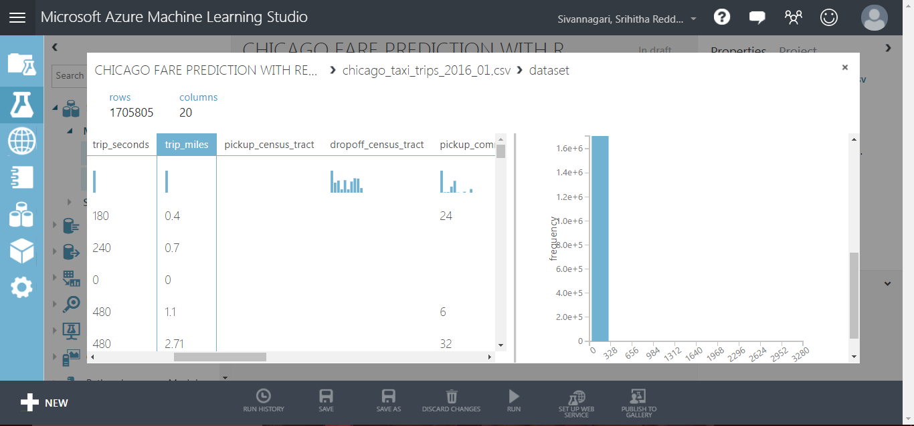

Slide 40
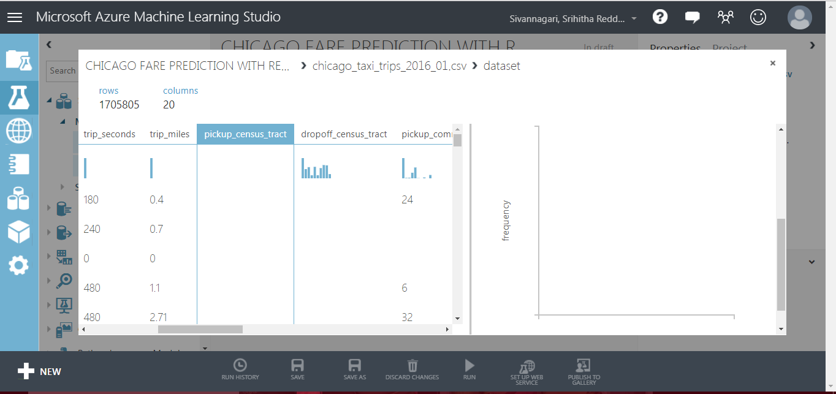

Slide 41
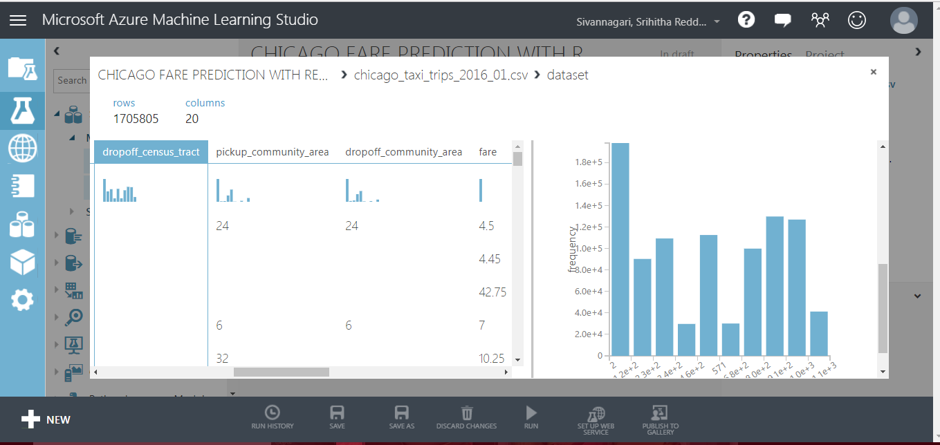

Slide 42
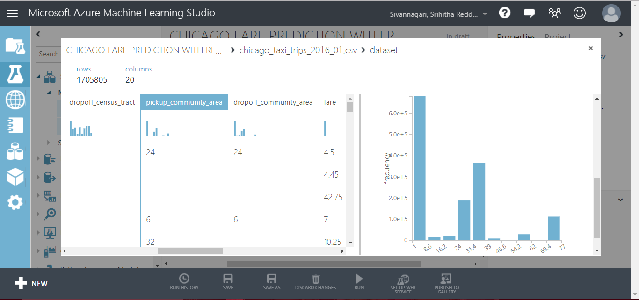

Slide 43
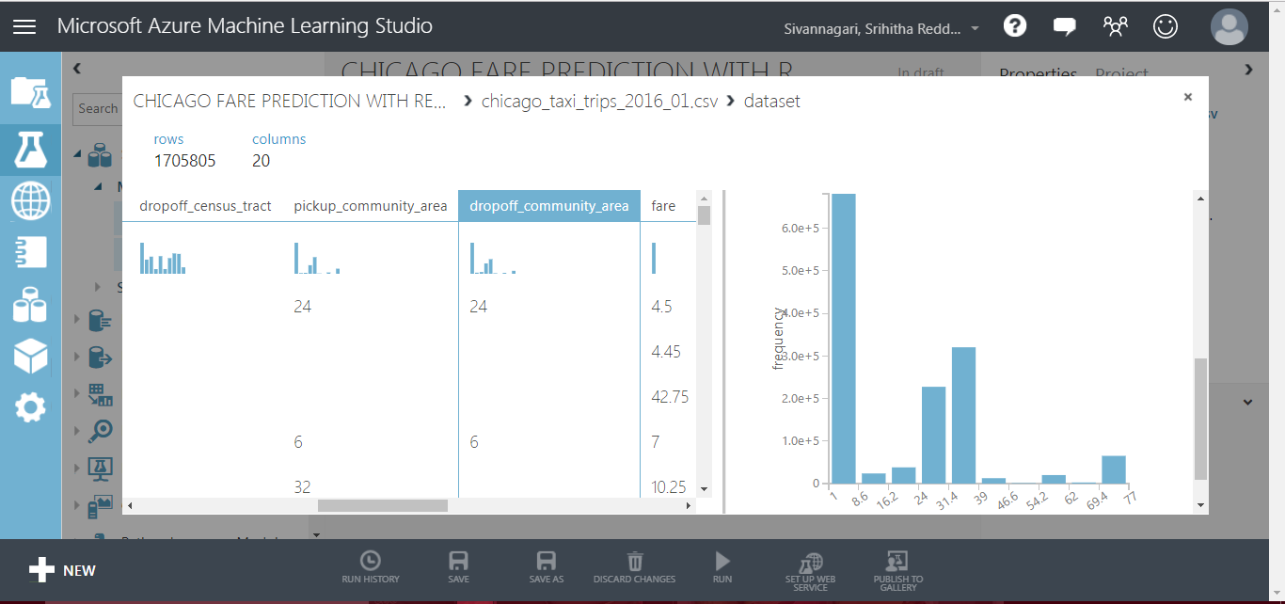

Slide 44
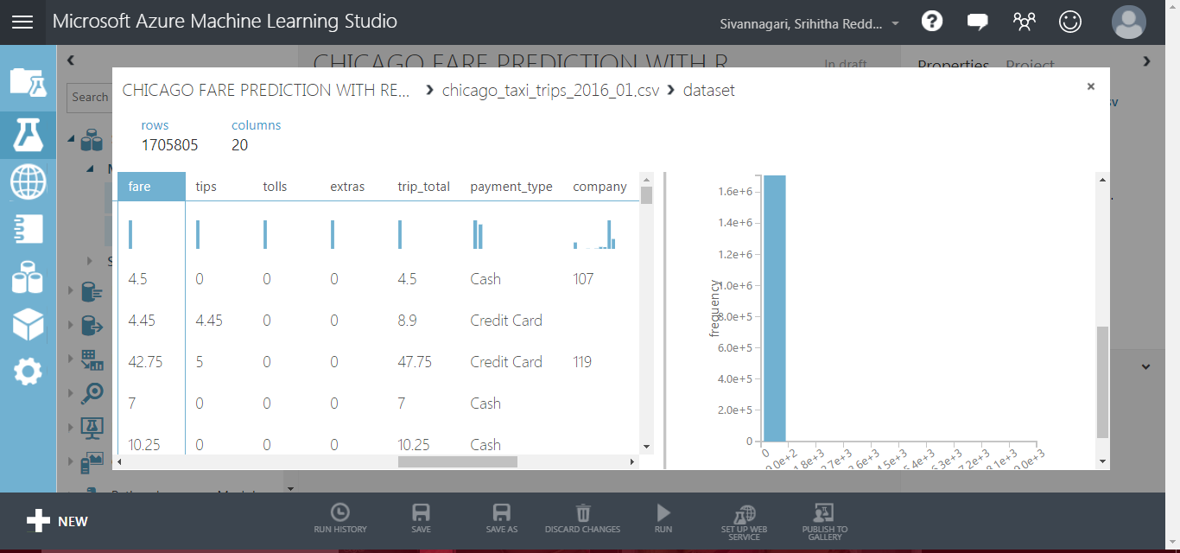

Slide 45
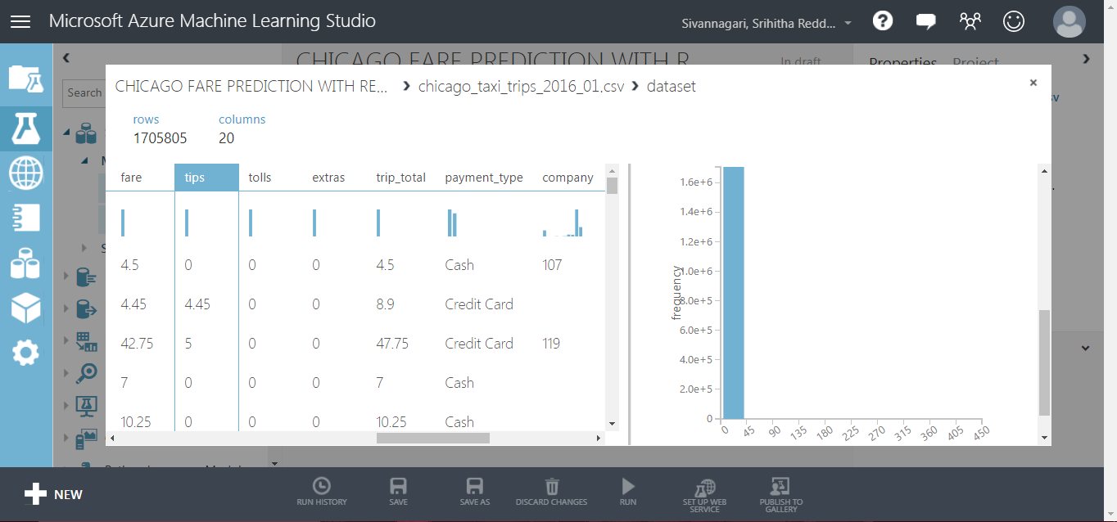

Slide 46
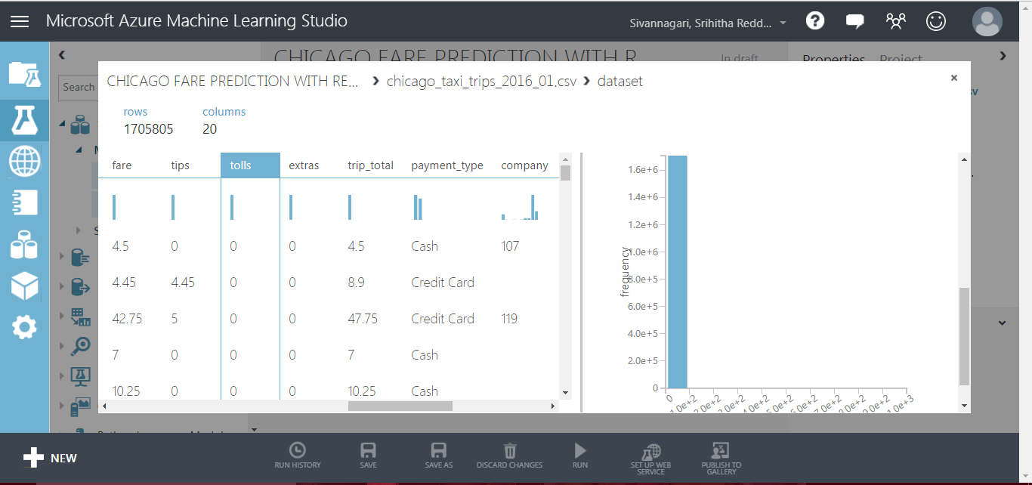

Slide 47
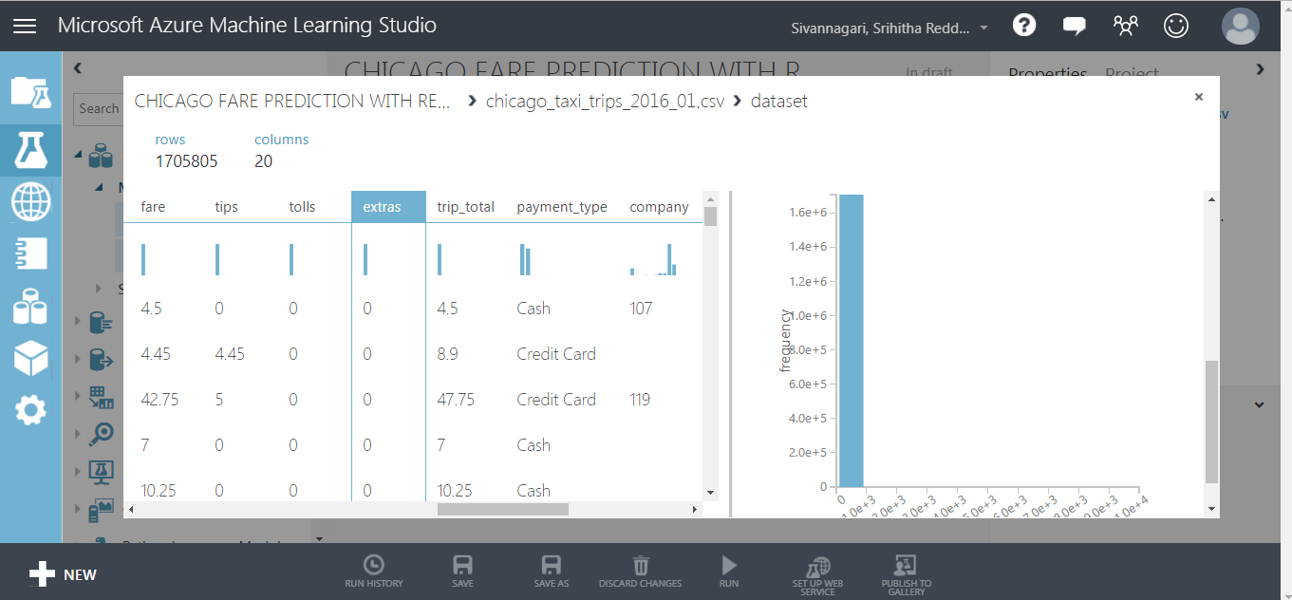

Slide 48
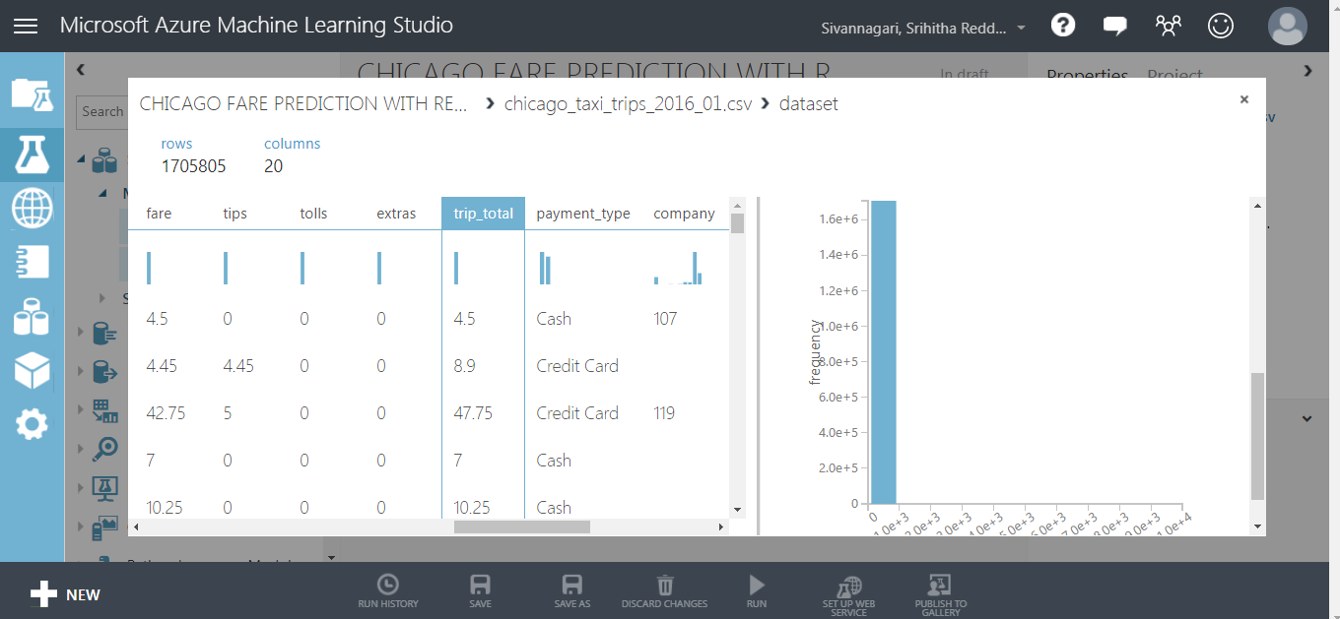

Slide 49
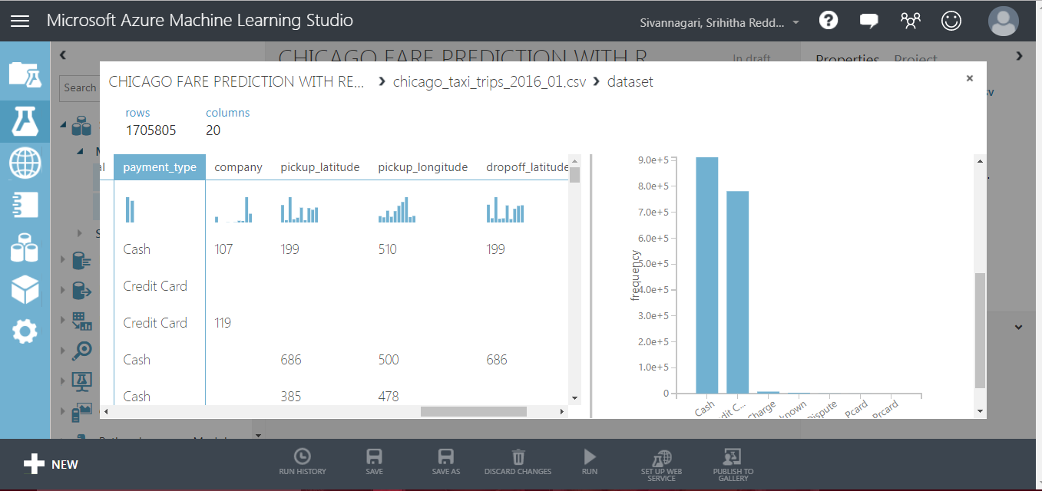

Slide 50
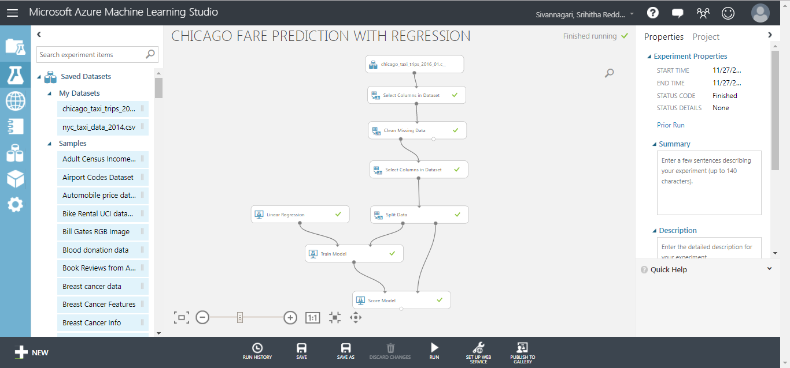

Slide 51
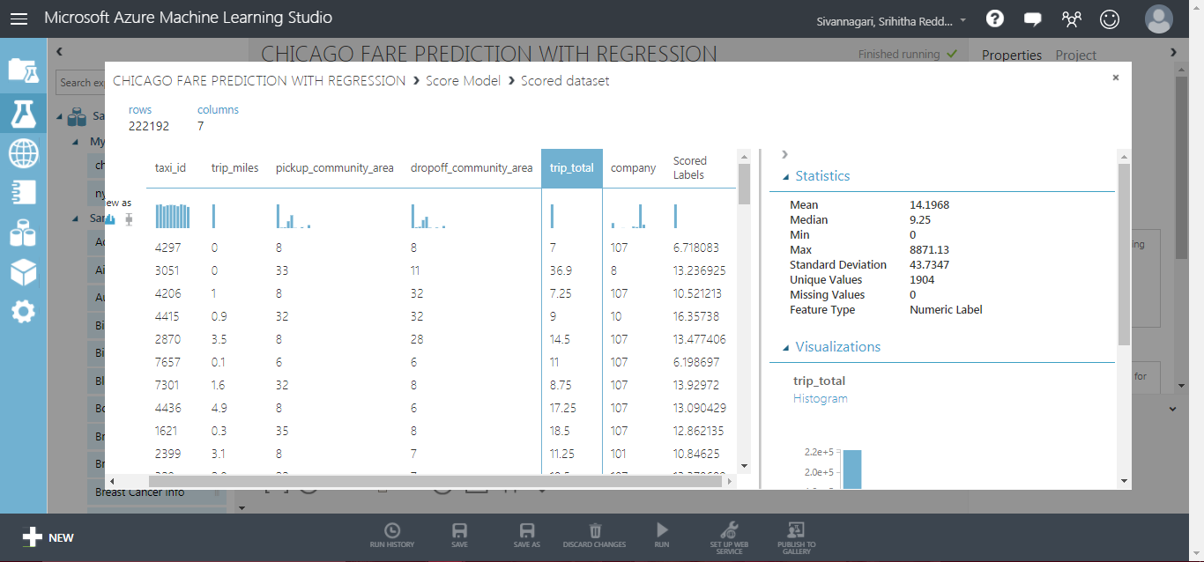
SCORED LABELS – TRIP_TOTAL

Slide 52
75% USED FOR TRAINING AND 25% USED FOR TESTING
SPLIT DATA

Slide 53
Conclusion
From the analysis we have carried out on the existing data and predictive analysis helped us understand that Chicago is a better city to start a business.

Slide 54
REFERENCES
https://docs.microsoft.com/en-us/azure/machine-learning/studio/create-experiment
https://www.qubole.com/resources/pig-function-cheat-sheet/
https://www.cloudera.com/documentation/enterprise/5-8-x/PDF/cloudera-hive.pdf
GitHub

